Slide 1
Flight Booking System
Introduction :
Created an Graphical User Interface (GUI) using Tkinter. By using various concepts of the Tkinter such as Labels, Input Entry, Checkbox, Datebox, Messagebox, Image, Dropdown List, etc.
Airline reservation systems (ARS) are systems that allow an airline to sell their inventory (seats). It contains information on schedules and fares and contains a database of reservations (or passenger name records) and of tickets issued (if applicable). ARSs are part of passenger service systems (PSS), which are applications supporting the direct contact with the passenger.
ARS eventually evolved into the computer reservations system (CRS). A computer reservation system is used for the reservations of a particular airline and interfaces with a global distribution system (GDS) which supports travel agencies and other distribution channels in making reservations for most major airlines in a single system.

Slide 2
Objective :
Airline reservation systems (ARS) are systems that allow an airline to sell their inventory (seats). It contains information on schedules and fares and contains a database of reservations (or passenger name records) and of tickets issued (if applicable). ARSs are part of passenger service systems (PSS), which are applications supporting the direct contact with the passenger.
ARS eventually evolved into the computer reservations system (CRS). A computer reservation system is used for the reservations of a particular airline and interfaces with a global distribution system (GDS) which supports travel agencies and other distribution channels in making reservations for most major airlines in a single system.
Airline reservation systems incorporate airline schedules, fare tariffs, passenger reservations and ticket records. An airline's direct distribution works within their own reservation system, as well as pushing out information to the GDS. The second type of direct distribution channel are consumers who use the internet or mobile applications to make their own reservations. Travel agencies and other indirect distribution channels access the same GDS as those accessed by the airline reservation systems, and all messaging is transmitted by a standardized messaging system that functions on two types of messaging that transmit on SITA's high level network (HLN). These messaging types are called Type A [usually EDIFACT format] for real time interactive communication and Type B [TTY] for informational and booking type of messages. Message construction standards set by IATA and ICAO, are global, and apply to more than air transportation. Since airline reservation systems are business critical applications, and they are functionally quite complex, the operation of an in-house airline reservation system is relatively expensive

Slide 3
Background :
Flight Booking systems incorporate airline schedules, fare tariffs, passenger reservations and ticket records. An airline's direct distribution works within their own reservation system, as well as pushing out information to the GDS. The second type of direct distribution channel are consumers who use the internet or mobile applications to make their own reservations. Travel agencies and other indirect distribution channels access the same GDS as those accessed by the airline reservation systems, and all messaging is transmitted by a standardized messaging system that functions on two types of messaging that transmit on SITA's high level network (HLN). These messaging types are called Type A [usually EDIFACT format] for real time interactive communication and Type B [TTY] for informational and booking type of messages. Message construction standards set by IATA and ICAO, are global, and apply to more than air transportation. Since airline reservation systems are business critical applications, and they are functionally quite complex, the operation of an in-house airline reservation system is relatively expensive.
Prior to deregulation[clarification needed], airlines owned their own reservation systems with travel agents subscribing to them. Today, the GDS are run by independent companies with airlines and travel agencies being major subscribers.
As of February 2009, there are only four major GDS providers in the market: Amadeus, Travelport (which operates the Apollo, Worldspan and Galileo systems), Sabre and Shares. There is one major Regional GDS, Abacus, serving the Asian market and a number of regional players serving single countries, including Travelsky (China), ORS (Russia), Infini and Axess (both Japan) and Topas (South Korea). Of these, Infini is hosted within the Sabre complex, Axess is in the process of moving into a partition within the Worldspan complex, and Topas agencies will be migrating into Amadeus.
Reservation systems may host "ticket-less" airlines and "hybrid" airlines that use e-ticketing in addition to ticket-less to accommodate code-shares and interlines.
In addition to these "standardized" GDS, some airlines have proprietary versions which they use to run their flight operations. A few examples are Delta's OSS and Deltamatic systems and EDS SHARES. SITA Reservations remains the largest neutral multi-host airline reservations system, with over 100 airlines currently managing inventory.

Slide 4
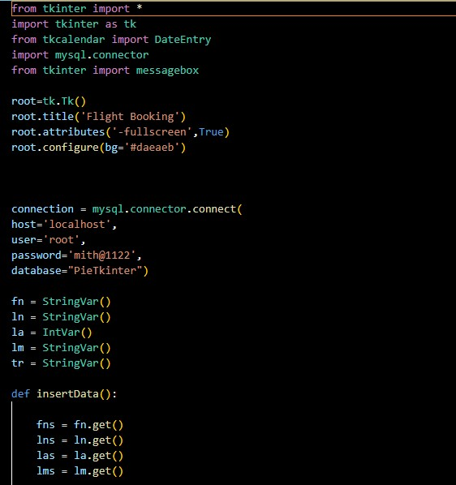
Code :

Slide 5
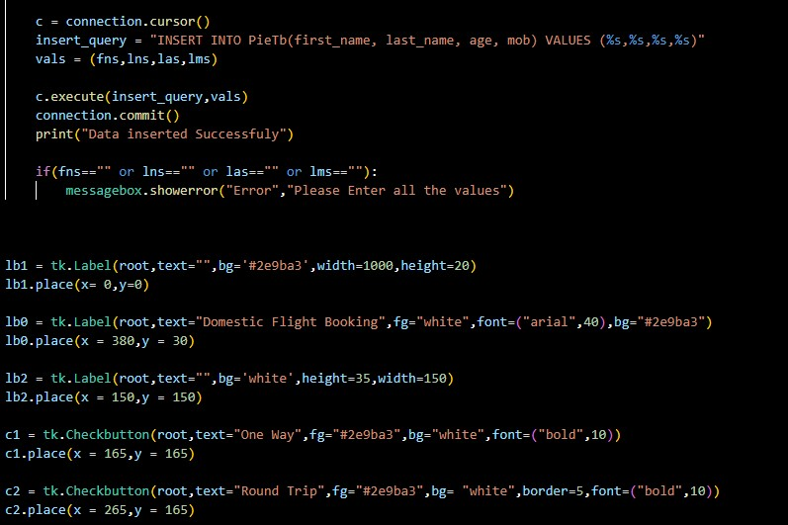

Slide 6
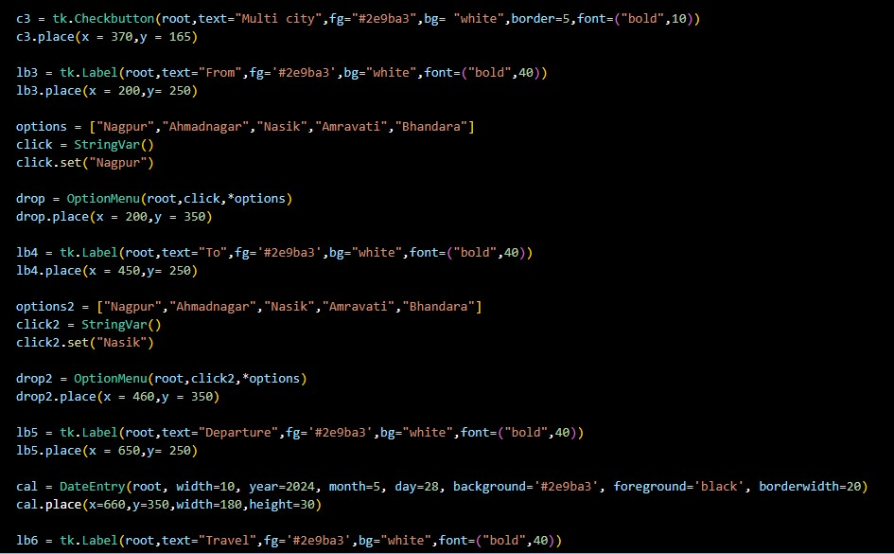

Slide 7
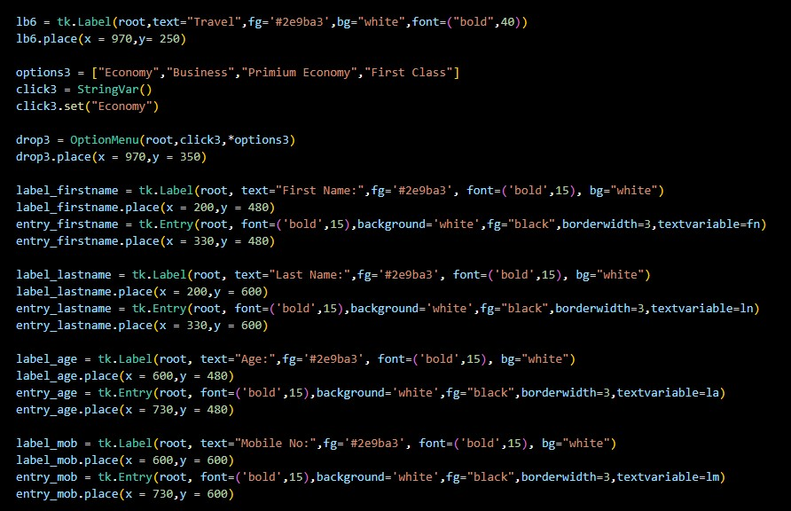

Slide 8
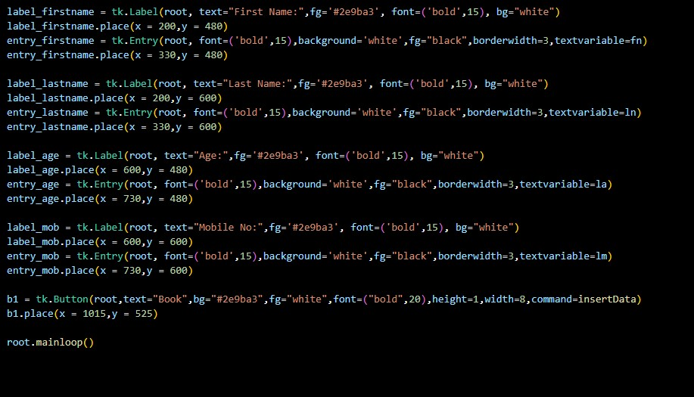

Slide 9
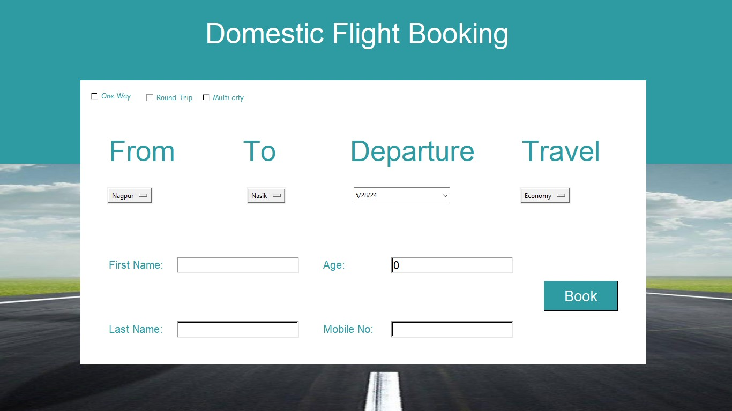
Output :

Slide 10
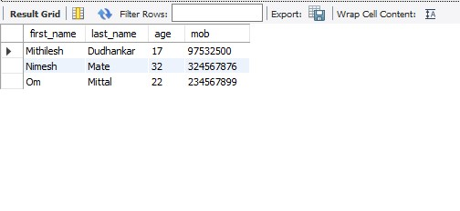

Slide 11
Future Scope :
Flight booking
While OTAs and metasearch engines are the preferred option at the search stage, the majority of travelers go to airline websites when it comes to booking. There are two main reasons for this.
First, when purchasing seats directly from the airline, it will be simpler, even from the technical perspective, to make changes to the reservation or cancel the flight. Second, travelers get access to a broader selection of ancillaries than OTAs typically provide.
No matter the source of booking, the airline CRS has to check if the flight product in question is still available for reservation. Then, it replies to the travel retailer with the status code HK (“holding confirmed”.) The alternative answer is UN, meaning that the carrier is unable to satisfy the request.
Another task of the CRS at this step is to create a PNR. In the course of booking, a retailer -- be it an OTA or airline website — collects personal data such as a passenger name and contacts and redirects it to the CRS. Once all mandatory details are gathered, the system generates a PNR number that works as an electronic address of the file in the database.

Slide 12
Conclusion :
Sucssesfully learned how to work with Tkinter and data passing with SQL data base. And various concepts of Tkinter like Image, Date, messagebox, dropdown list, Checkbox etc.

Slide 13
References :
https://en.wikipedia.org/wiki/Airline_reservations_system
https://www.altexsoft.com/blog/flight-booking-process-structure-steps-and-key-systems/

